Slide 1
2048 Project
Austin Veselka

Slide 2

I began, as all things, with Initiative. Over a year ago, I found a passion for computer science that originated in a series of challenges designed to teach the programming language Python. In less than a month, I’d become what I would call a proficient user of an entirely new language.

Slide 3
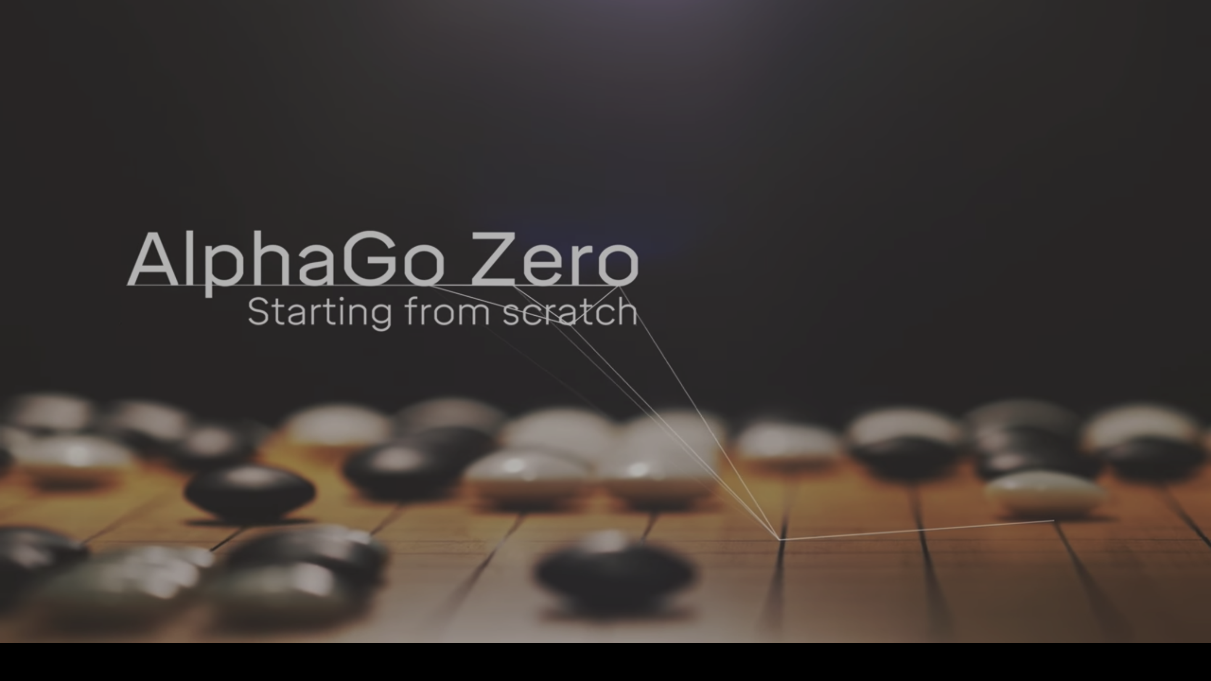
My pursuit of Artificial Intelligence (AI) began here, but it wasn’t so simple as beginning. The most significant step in pursuing Growth is realizing that an idea can become reality. A simple fact, that most work in AI is done in the language Python, something I now knew and understood, sparked the realization that I could realistically pursue and build AI. This, such a complex and fascinating field of research, involving the complexities of our own sentience and the lore that follows in the trail of all the major accomplishments of AI, became a goal.

Slide 4


As I have learned over the past year and a half chasing the most efficient methods of learning without the direction of school, classes or even someone who knew what they were doing, one of the most daunting tasks of self-teaching is organizing what you want to learn and a path to that end. This, I would say, is the role of Tenacity.
Tenacity is what drives me to draw the crucial path between where I am and where I want to be in the face of a directionless goal. At the beginning of this semester, equipped with the high-level calculus and programming skills necessary to build AI, I enrolled in an online master’s level course on AI.

Slide 5
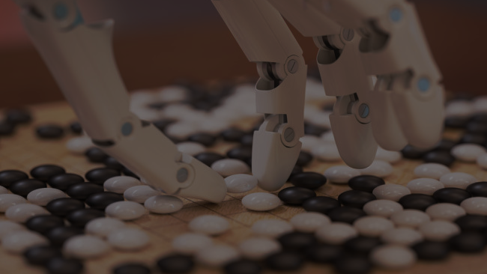
Resilience lies in the pursuit. Throughout the semester, I have spent much of my free time learning the algorithms and ideas used to approach various problems in the field. Drawing from lectures, articles and research papers I have completed a multitude of projects showcasing my solutions to different problems. Of these, one displays the fascinating quality of intelligent behavior.

Slide 6
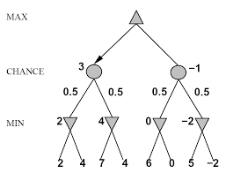
The challenge was to create an AI to play the game 2048. There are many ways to accomplish this and many more effective than mine. This makes it all the more amazing that I can observe intelligent or even human-like behavior in the decisions of my solution. As such, I will showcase some of the more interesting behaviors displayed along with some of the reasoning behind it.

Slide 7
If you are not familiar with this game, I believe it will make the showcase more interesting and far easier to understand, so I suggest that you play the game here: https://2048game.com/ (the controls are your arrow keys) and/or familiarize yourself with the rules below:
The game is set in a 4x4 grid. There are four movements you can make: Up, Down, Left or Right. Each move will slide all tiles on the board as far as possible in that direction until it encounters another tile of the same value or the edge of the board. All tiles of the same value that collide while moving will combine to a tile with twice the value of the two tiles that combined. A tile cannot combine more than once in a single movement. After every move and at the beginning of the game, a tile of value two or four will spawn in a random location not already occupied. The game ends when there are no possible moves remaining and the board is full. The goal of the game is to attain a tile of value 2048. You can also continue to play past this mark and try for 4096 or even higher goals.

Slide 8
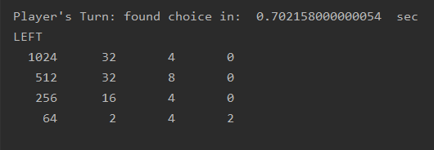
One of the most obvious behaviors is that high tiles are kept in the corner and subsequently lower tiles are in order in the same row or column. This is widely recognized as a powerful strategy for reaching the 2048 tile.

Slide 9
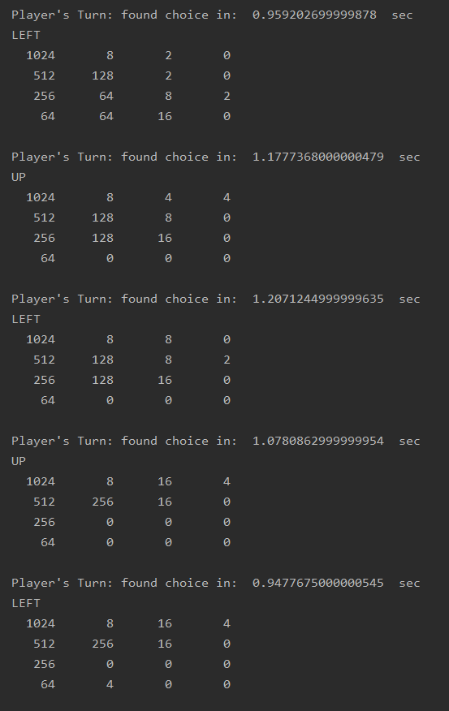
The AI’s decisions are shown in the top left corner. Notice the second column and the bottom left corner of the game at the top. Here, you could choose to move left, combining the two 64 tiles. This may seem like a fairly good decision. However, notice also that if you were to move either up or down, you would have an easy time making a 256 tile which could also be easily combined into the 256 in the far-left column. This decision is ultimately the one that leads to the 2048 tile the most efficiently. This level of effective comparison is very interesting to observe and challenging to obtain.

Slide 10
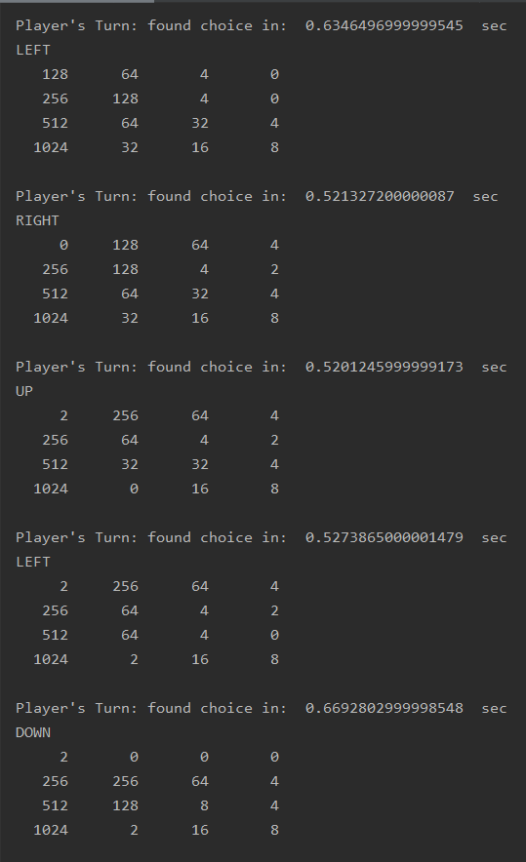
Look at the first board.
I suspect your attention was immediately directed towards the top-left corner where you might have begun wondering how to combine the two 128’s. Accomplishing this leads to a very simple sequence of downward moves that results in the 2048 tile. In a very surprisingly clever strategy, notice the right side of the board where the AI has built up tiles so that when it moves right, none of the important tiles are displaced from the left column and it can combine the two 128 tiles. This buildup occurred over a long period of time and many decisions indicating either very effective long-term planning, or perhaps just opportunism.

Slide 11
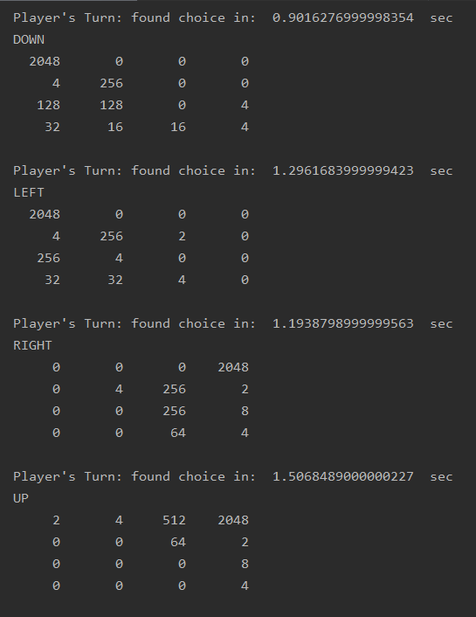
You can see a clever set of decisions that turn a very bad looking state into a very good one (one that has the highest tile in the corner and decreases along the row or column). The AI has also achieved the 2048 tile and is playing for 4096, which it has achieved once so far. In fact, it plays so well that from just watching I have learned how to play well enough to reach 2048 consistently.

Slide 12
This AI is of itself a display and a manifestation of growth, resilience, initiative, tenacity and their meanings to me. The focus of my application is this AI, or the 2048 project, which is the culmination and result of failures, successes, the pursuit of a goal and a passion.
Growth lies in your ideas; they can be real.
Resilience lies in the pursuit; you decide when it ends.
Initiative is a beginning, the belief in your pursuit and the first step along the path you draw.
Tenacity is a head held high in the face of not only your goals, but where you want to be.

